Slide 1

Stock Analysis & Portfolio Management
By –
Sakshi Agarwal

Slide 2
Business Case
With lack of skill or shortage of time, a need to identify right investment opportunity for individual/business to get maximum returns has given rise to dedicated individuals called Portfolio Managers investing on their behalf with commission.
The main objective of Portfolio Manager is to realize the investor needs and suggest a suitable portfolio that meets all the expectations. They are responsible for establishing the best investment strategy, selecting appropriate investments along with right allocation.
I am working at an investment firm that manages accounts for private clients and my role is to analyze a portfolio of stocks to provide consultation on investment management based on client’s requirement.
Our investor is Ms. Alexandra Koslishnyick who is a potential client, and we are required to create a portfolio for her which gives decent returns and involves low risk.
Here, we are provided with 12 different stock price data that belongs to 4 Industry Groups – Aviation, Finance, Healthcare & Technology along with price of Market Index S&P500.
The dataset contains 10 years of data from 1st Oct 2010 to 30th Sep 2020.

Slide 3
Process Steps
Business Case – Structured Problem Solving
Preliminary Steps - Data loading
Data Exploration
Stock Analysis and Portfolio Management - CAPM
Stock Price Prediction - Validation
Reporting

Slide 4
Preliminary Step - Data Loading
Understanding the Domain/Variables
Read/Load the Dataset
Inspect/Check the structure of dataframe
Data Cleaning
Merge the different stock files
Keep the required attributes

Slide 5
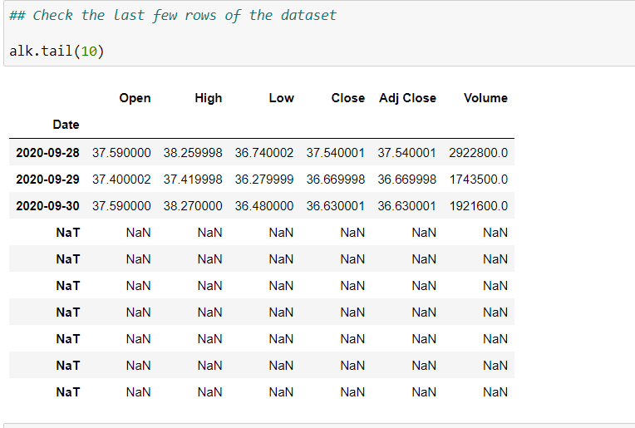
Data Cleaning/Merging
Convert/Fix Incorrect Datatypes – Date Column.
Set The Date column as Index.
Handling Missing Values.
No outliers present.
Merge the stock files into single dataset.
Removing extra records from few datasets.
Keep only the required columns – Close Price & Volume.
The screenshot shows NULL records in one of the stock file which
has been removed from the dataset.

Slide 6
Data Exploration
Daily and Normalized Stock Price Visualization
Perform calculation of various metrics –
Returns – Daily Returns, Mean of Returns, Annualized Returns
Statistical Summary
Risk/Volatility – Standard Deviation
Cumulative Returns
Correlation among stocks and different industry Groups
Comparison & Findings

Slide 7
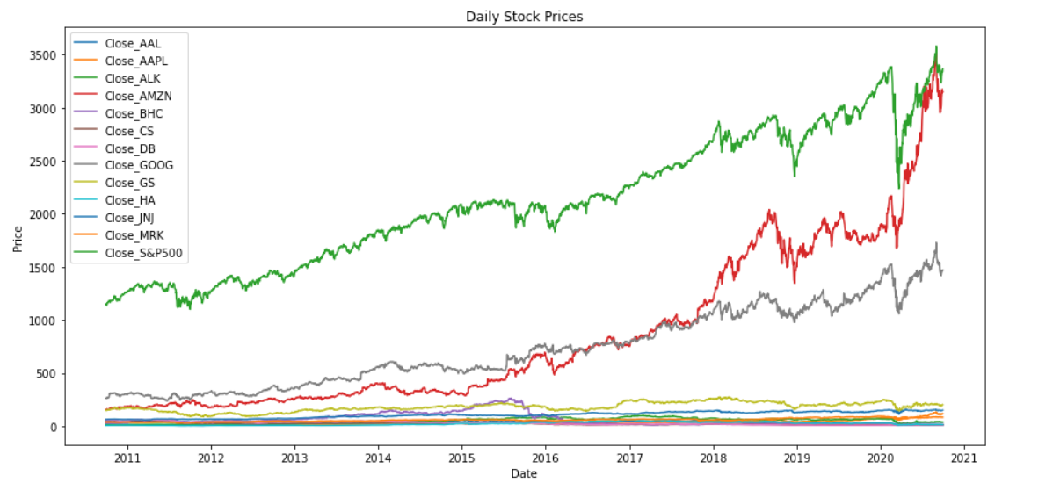
Daily Stock Prices

Slide 8
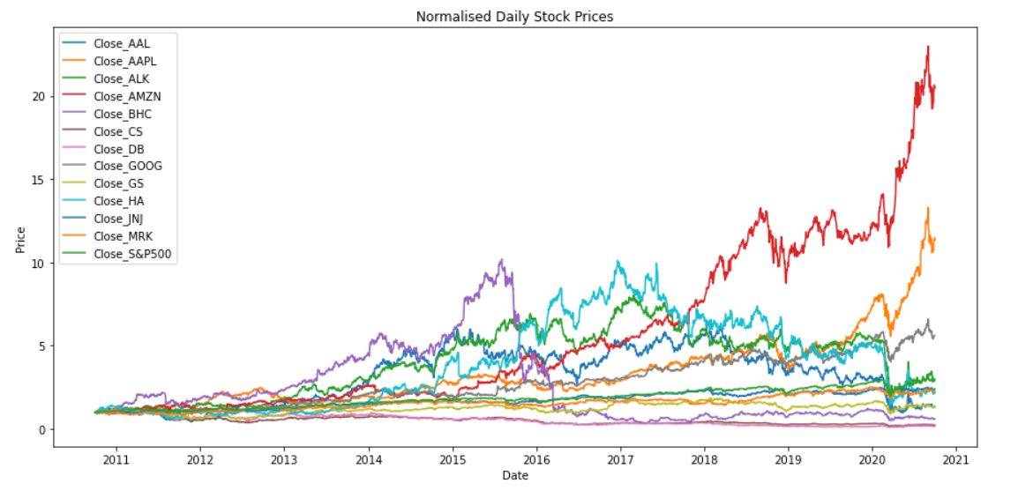
Daily Stock Prices - Normalized

Slide 9
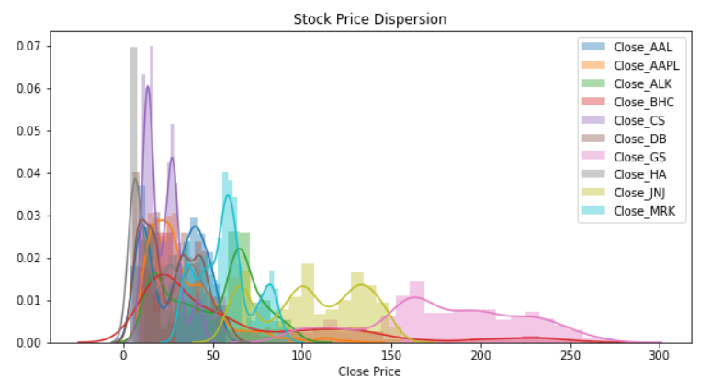
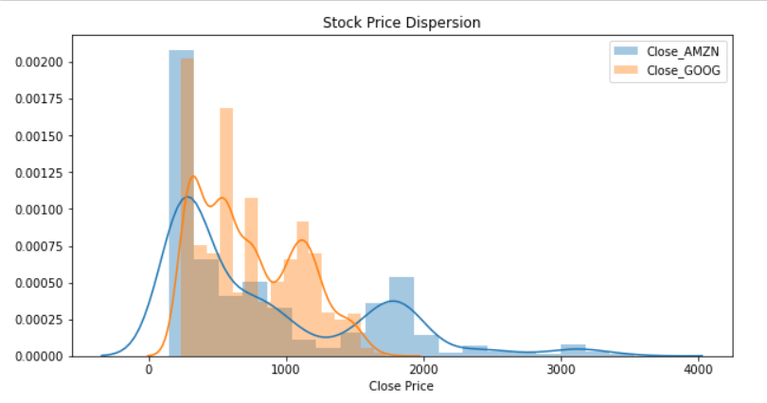
Distribution – Stock Prices
Distribution Plot for various stocks provided.

Slide 10
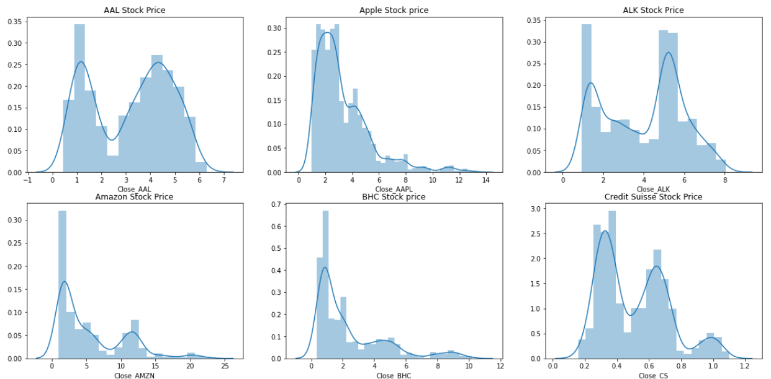
Distribution – Stock Prices

Slide 11
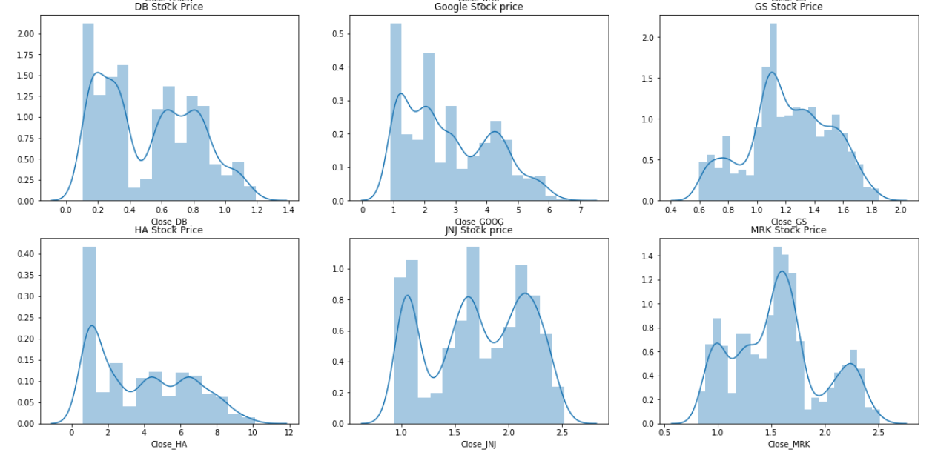
Distribution – Stock Prices

Slide 12
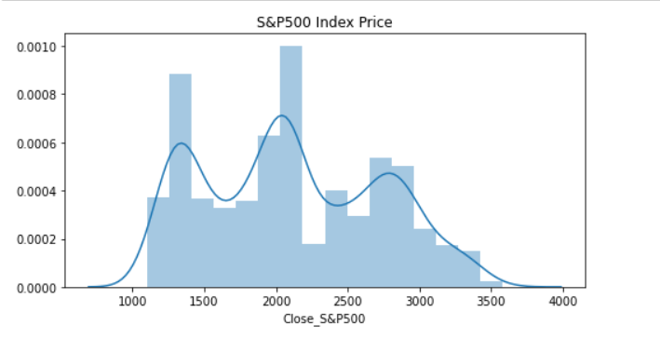
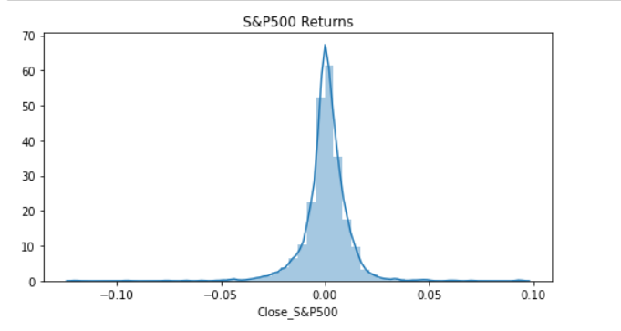
Distribution – Market Index S&P500 Price & Returns
S&P500 Returns is normally distributed while Price is more dispersed.

Slide 13
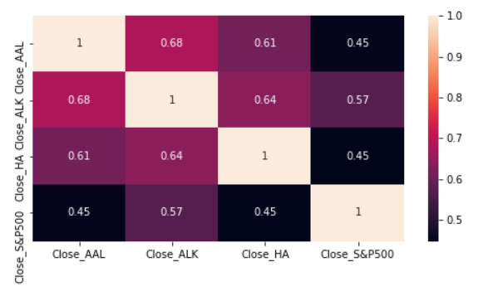
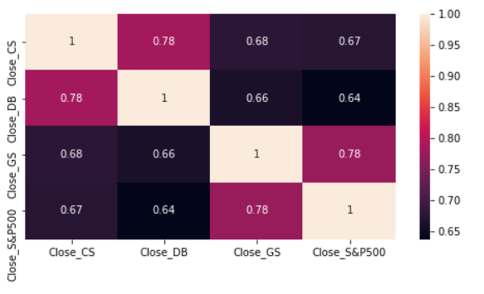
Correlation Heatmap – Industry Groups
Aviation
Finance
In Aviation – none of the stocks are correlated with Market Index.
In Finance – Goldman Sachs, Deutsche Bank & Credit Suisse have correlation with S&P500.

Slide 14
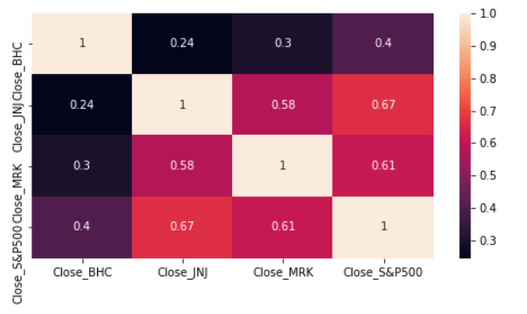
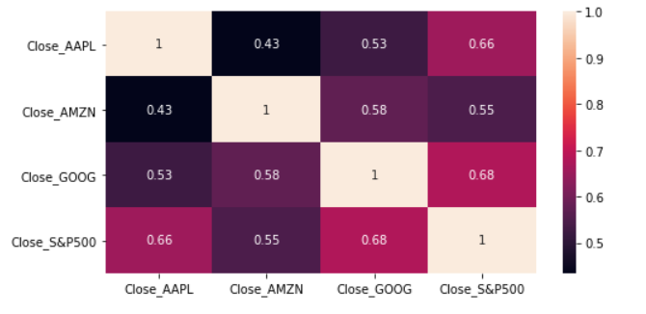
Correlation Heatmap – Industry Groups
Healthcare
Technology
In Healthcare – Johnson & Johnson and Merck and CO are correlated with Market Index.
In Technology – Google & Apple are correlated with S&P500.

Slide 15
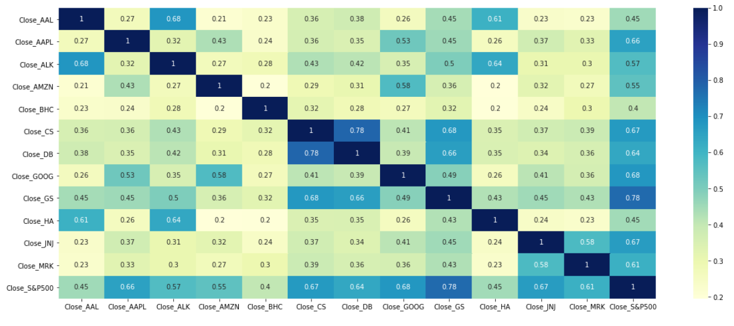
Correlation Heatmap

Slide 16
Comparisons & Findings – I
Daily Stock Prices –
Highest Stock prices - Amazon , Apple and Google.
Prices of Bausch Health, Hawaiian Holdings, American Airlines have dropped in recent years.
Apple & Goldman Sachs seems to be normally distributed with S&P500
S&P500 Index Price is more dispersed from mean.
Daily Returns –
S&P500 Returns is normally distributed.
All the stock returns are normally distributed.
Average Daily Returns, Annualized and Cumulative Returns –
Amazon has highest Returns followed by Apple & Google.
Deutsche Bank has lowest Returns.

Slide 17
Comparisons & Findings – II
Risk and Annualized Risk –
Most Risky Assets - Bausch Health, American Airlines Group & Hawaiian Holdings.
Johnson & Johnson is least risky asset.
Correlation Analysis –
Aviation – none of the stocks are correlated with Market Index.
Finance – Goldman Sachs, Deutsche Bank & Credit Suisse have correlation with S&P500.
Healthcare – Johnson & Johnson and Merck and CO are correlated with Market Index.
Technology – Google & Apple are correlated with S&P500.
Among each other – Deutsche Bank & Credit Suisse have strong correlation with each other, and American Airlines & Alaska Air Group are also correlated with each other along with Hawaiian Holdings.

Slide 18

Stock Analysis and Portfolio Management – CAPM

Slide 19
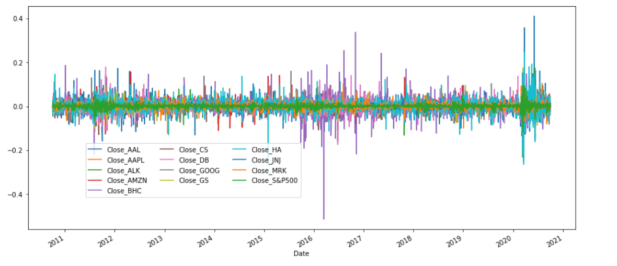
Distribution – Daily Returns

Slide 20
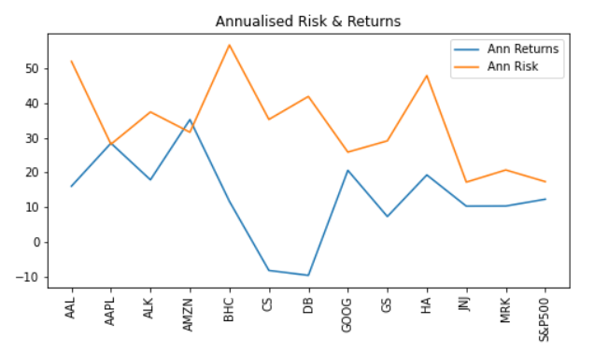
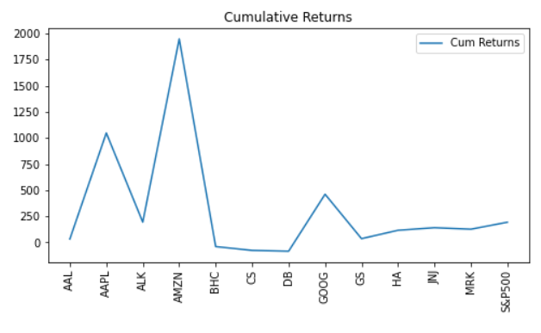
Annualized Risk, Annualized Returns & Cumulative Returns
Annualized & Cumulative Returns are high for Amazon and low for Deutsche Bank while Annualized Risk is high for Bausch Health and low for Johnson & Johnson.

Slide 21
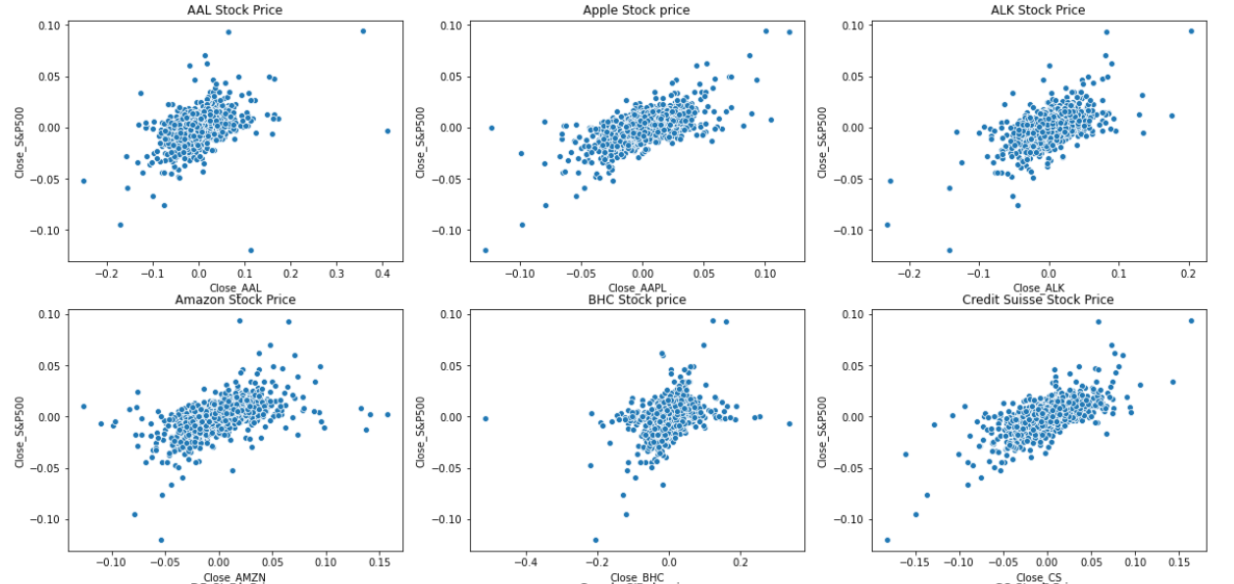
Stock vs Market Returns – Scatter Plot

Slide 22
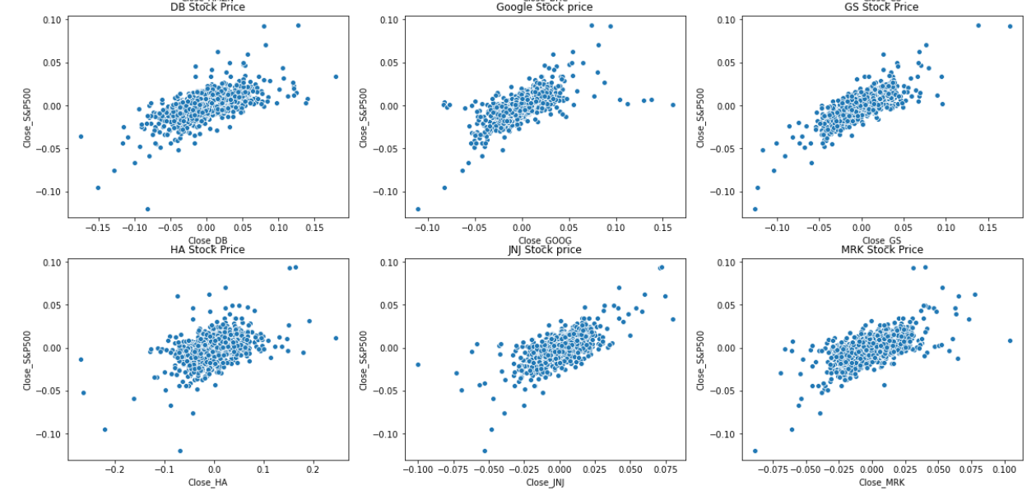
Stock vs Market Returns – Scatter Plot

Slide 23
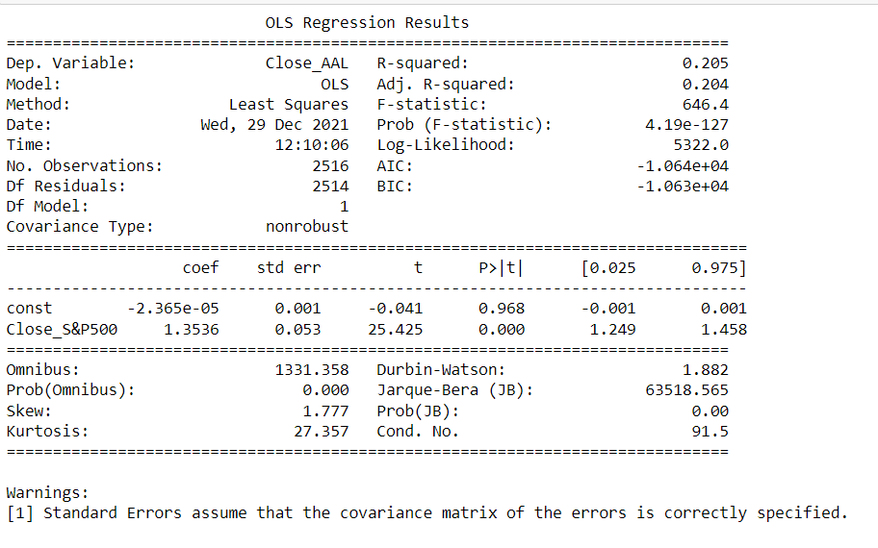
Beta Coefficient – Linear Regression
Stock – American Airlines Group Inc
Industry – Aviation
Beta Value – 1.3536
Adj R-square – 20.5%

Slide 24
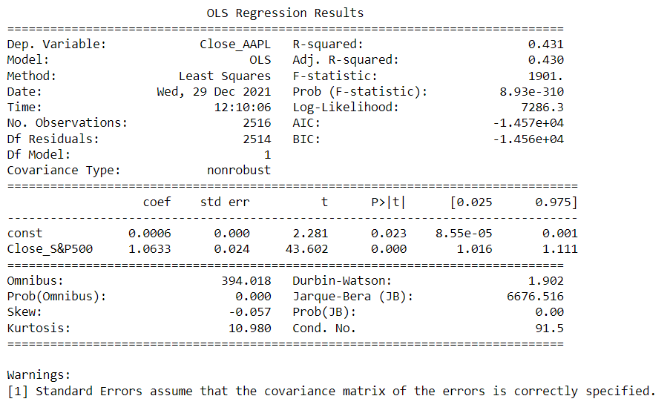
Beta Coefficient – Linear Regression
Stock – Apple Inc
Industry – Technology
Beta Value – 1.0633
Adj R-square – 43.1%

Slide 25

Beta Coefficient – Linear Regression
Stock – Merck and CO inc.
Industry – Healthcare
Beta Value – 0.7335
Adj R-square – 37.8%

Slide 26
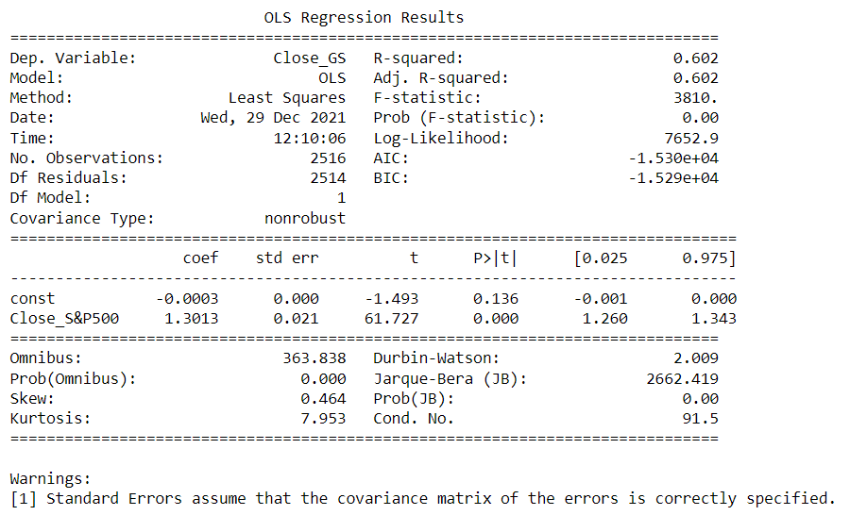
Beta Coefficient – Linear Regression
Stock – Goldman Sachs
Industry – Finance
Beta Value – 1.3013
Adj R-square – 60.2%

Slide 27
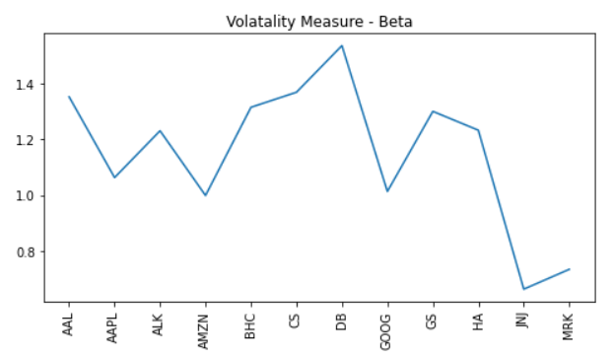
Beta Coefficient – Linear Regression
Other Stocks –
Alaska Air Group Inc – 1.231512
Amazon – 0.998802
Bausch Health Companies Inc – 1.315971
Credit Suisse – 1.370002
Deutsche Bank – 1.537546
Google – 1.013338
Hawaiian Holdings Inc – 1.233534
Johnson & Johnson – 0.662233
Stocks – Volatility/Beta Plot

Slide 28
Comparisons & Findings – I
On observing the Scatter Plots of stocks with Market Index, we can see that Apple , Goldman Sachs and Deutsche Bank seems
to be correlated with the market index.
Beta Values for American Airlines, Alaska Air, Bausch Health, Credit Suisse, Deutsche Bank, Goldman Sachs, Hawaiian Holdings
are depicting high volatility with respect to Market.
Beta values for Apple, Amazon, Google are correlated with the market.
Beta values for Johnson & Johnson and Merck and CO are less volatile than the market.
The Annualized Market Returns S&P500 is 12.3%.
Risk Free Rate given is 0.75%.
Expected Returns are hence calculated based on above metrics.
We will now compare the stocks with respect to below parameters for selection –
Beta Value
Annualized Risk
Cumulative Returns
Annualized Returns

Slide 29
Comparisons & Findings – II
Comparing the Beta values for different stocks as -
Beta ~1:
Google, Apple, Amazon - Low Risk, High Returns
Beta >1:
Deutsche Bank, Credit Suisse, Bausch Health - Negative Cumulative Returns, High Risk
American Airlines Group - Good Returns, High Risk
Goldman Sachs - Good Returns, Low Risk
Alaska Air Group - Good Returns, Less Risk
Hawaiian Holdings - High Returns, High Risk
Beta <1:
Johnson & Johnson, Merck and CO - High Returns, Less Risk

Slide 30
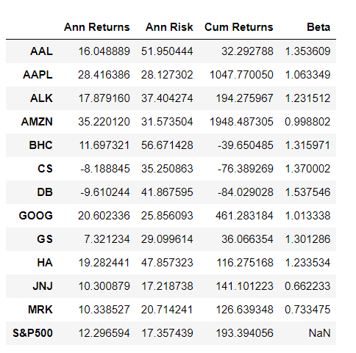
Stock Selection
Based on the analysis using Beta Value, Risk & Returns of stocks along with
the Investor Persona, we are choosing below stocks for our portfolio –
Google
Apple Inc
Goldman Sachs
Alaska Air Group Inc

Slide 31
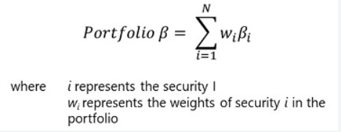
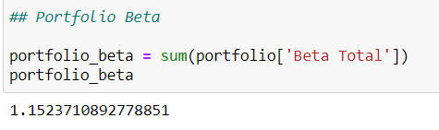
Portfolio Beta
Portfolio Beta – For a portfolio, the overall risk can be calculated as the weighted average of the risk of all the securities.
Result:- For our portfolio, Portfolio Beta is 1.1524

Slide 32
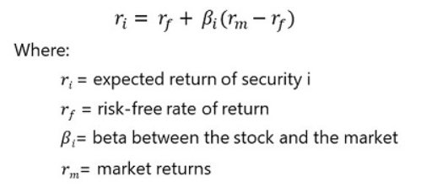
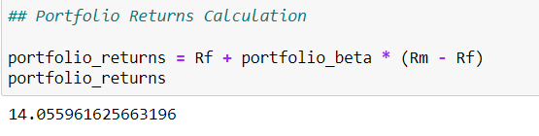
Portfolio Returns
Portfolio Returns – is the measure of returns of the Portfolio and calculated using Portfolio Beta times market returns and risk-free return.
Result:- For our portfolio, Portfolio Returns is 14.1%.

Slide 33
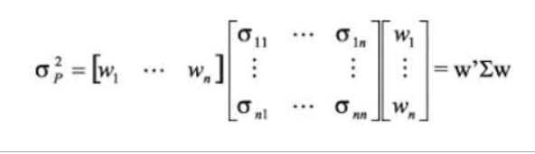
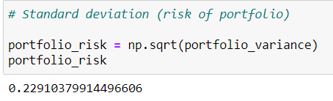
Portfolio Risk – Standard Deviation
Portfolio Risk – is the measure of risk in the portfolio and calculated using
Portfolio Weight Array
Portfolio Covariance Matrix
Transpose of Portfolio Weight Array
Result:- For our portfolio, Portfolio Risk is 22.91%.

Slide 34
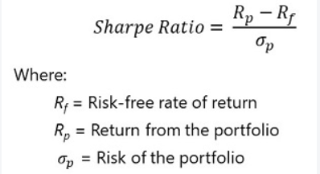
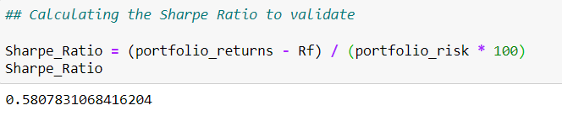
Sharpe Ratio
Sharpe Ratio - helps the investor to realize the excess returns earned to endure the extra volatility of a riskier asset.
Result:- For our portfolio, Sharpe Ratio comes is 0.58

Slide 35
Stock Price Prediction – Validation

Slide 36
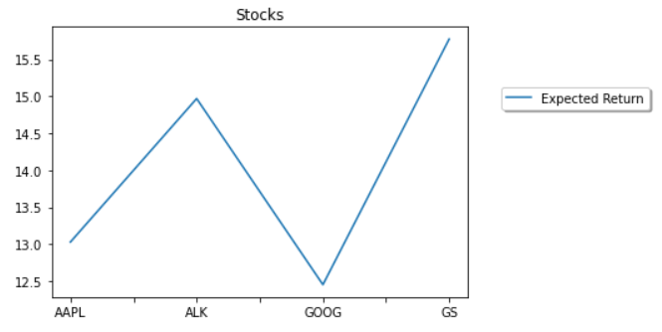
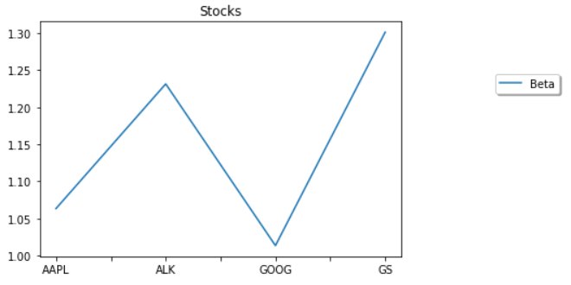
Selected Stocks – Returns & Beta Plot
Expected Returns & Beta value for Google is less among all selected stocks while Goldman Sachs has the highest value.

Slide 37
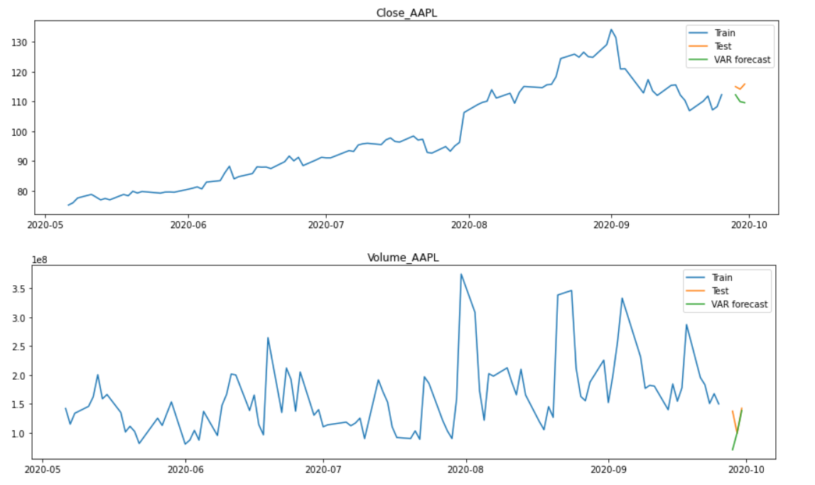
Model Building & Forecasting
Apple Close Price and Volume Prediction – Train, Test and Forecast

Slide 38
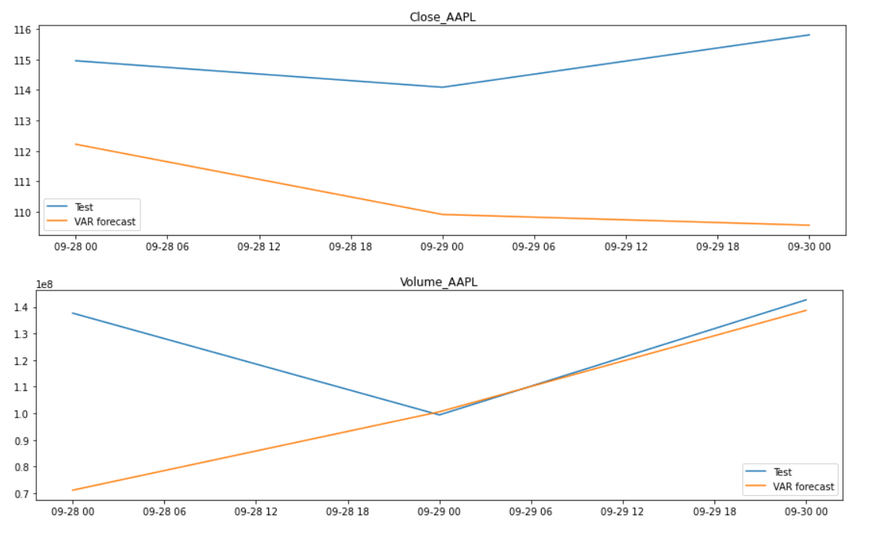
Model Building & Forecasting
Apple Close Price and Volume Prediction – Test and Forecast

Slide 39
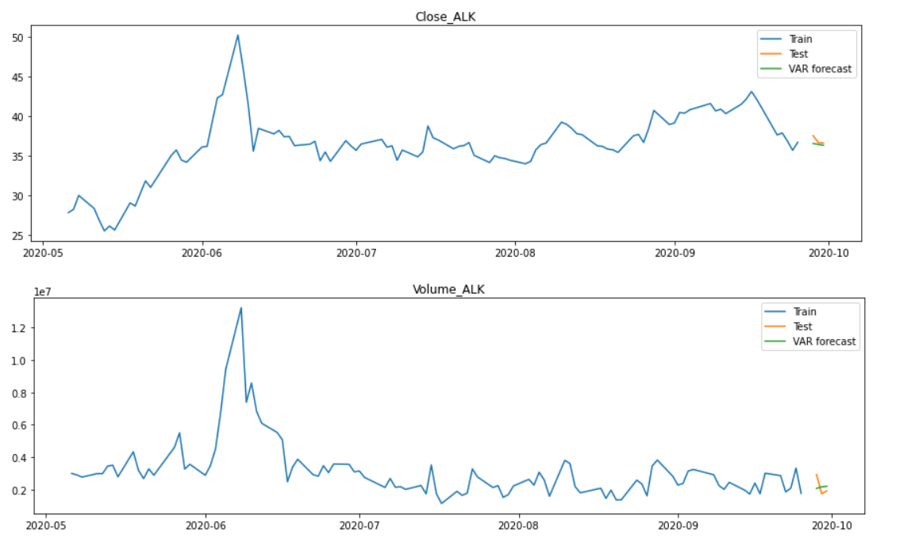
Model Building & Forecasting
Alaska Air Group Close Price and Volume Prediction – Train, Test and Forecast

Slide 40
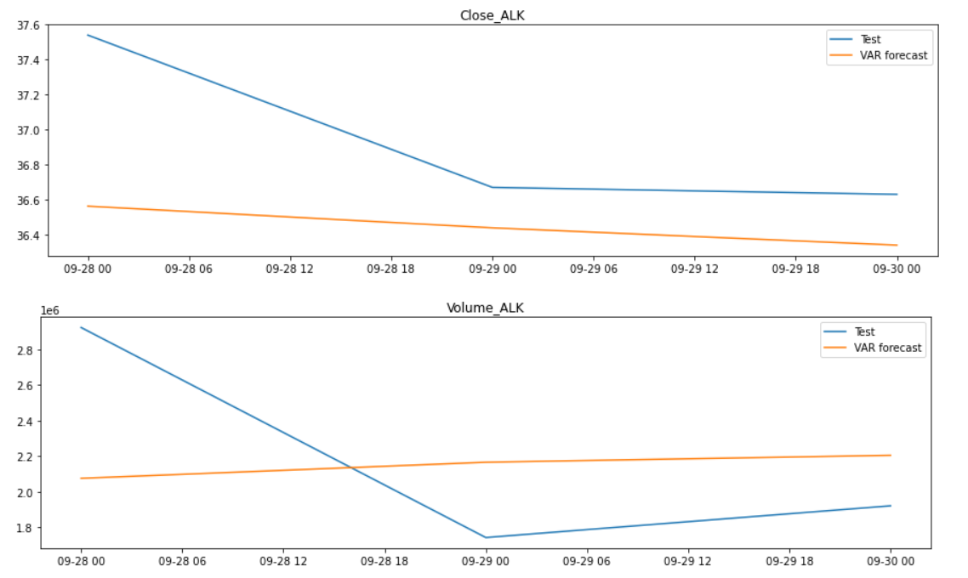
Model Building & Forecasting
Alaska Air Group Close Price and Volume Prediction – Test and Forecast

Slide 41
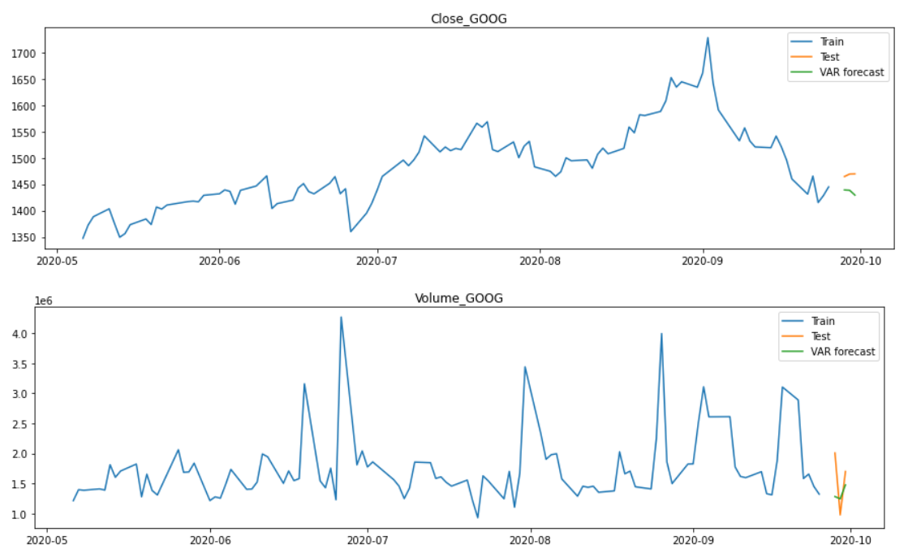
Model Building & Forecasting
Google Close Price and Volume Prediction – Train, Test and Forecast

Slide 42
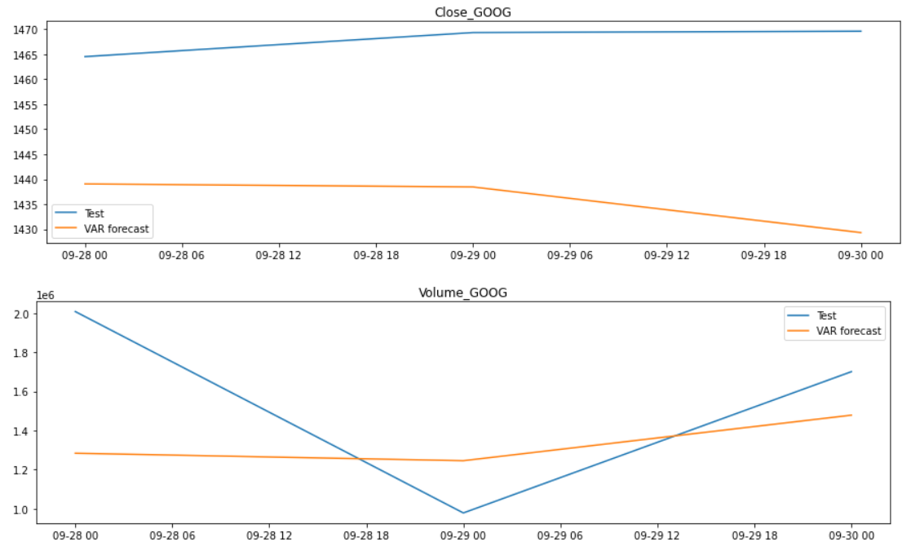
Model Building & Forecasting
Google Close Price and Volume Prediction – Test and Forecast

Slide 43
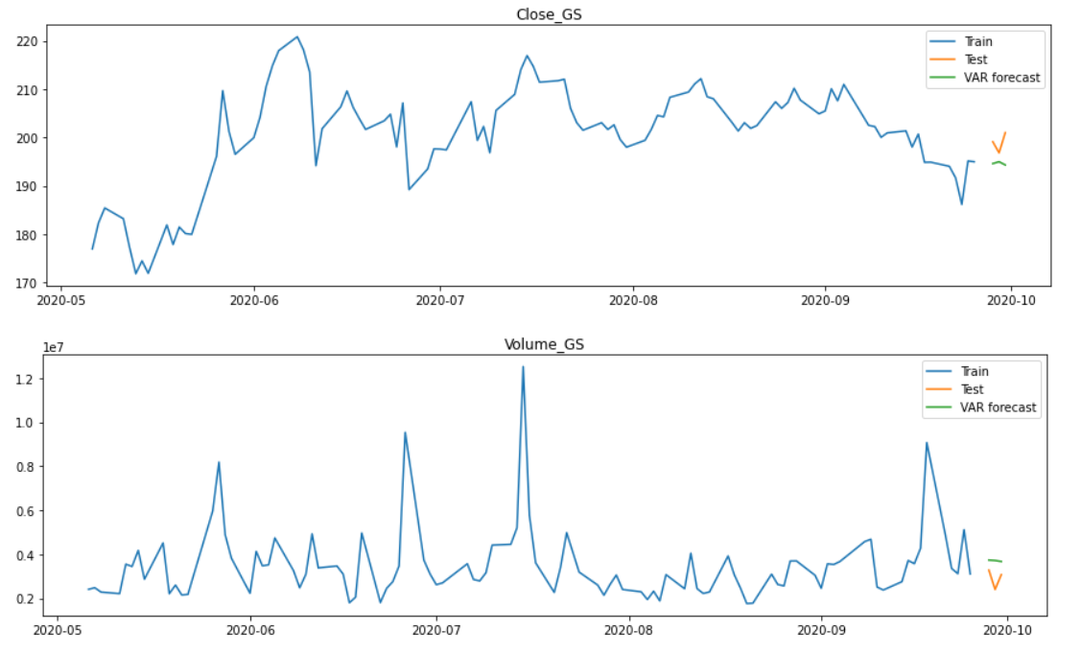
Model Building & Forecasting
Goldman Sachs Close Price and Volume Prediction – Train, Test and Forecast

Slide 44
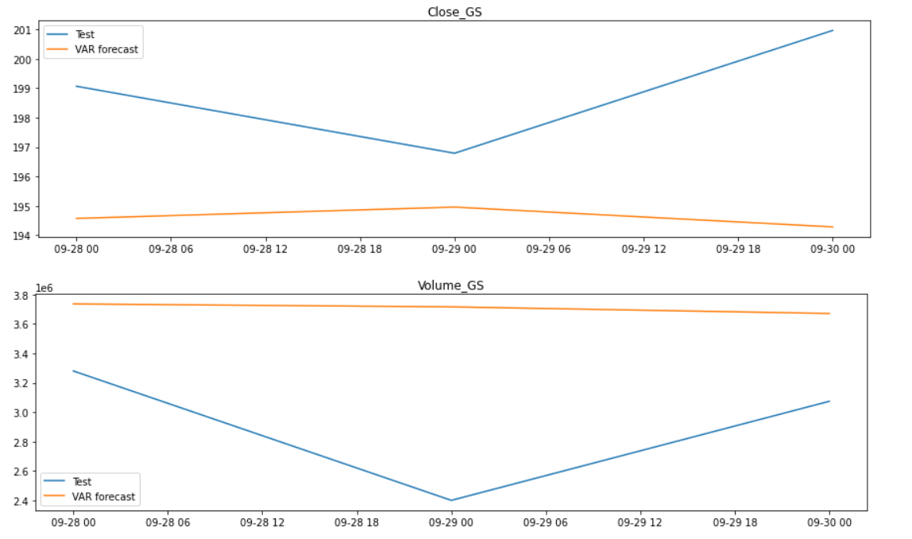
Model Building & Forecasting
Goldman Sachs Close Price and Volume Prediction – Test and Forecast

Slide 45
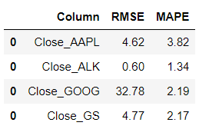
Comparison & Findings
Selected the test/validated set for 3 days for prediction/forecasting.
Alaska Air Group has close prediction with the test dataset as observed from the visuals/plots.
Alaska Air Group has the least RMSE and MAPE values when compared with the other selected stocks.
Google stock has the highest RMSE among all the selected stocks.
Apple has highest MAPE value among all the stocks.

Slide 46
Conclusion
Portfolio creation for our Investor – Ms. Alexandra Koslishnyick.
The investor wishes to invest in stocks which shows promise but also are stable.
All the stock files are merged/concatenated to a single dataset.
Datasets with NULL values and Inappropriate datatype ‘Date’ column were correctly handled.
No Outliers present in the dataset.
Calculation of different metrics – Returns, Risk/Volatility, Correlation Analysis.
Visualization/Comparison of various Stock/Normalized Stock Prices with Market Index S&P500.
Calculation of Beta values of stock with Market Index using Linear Regression.
Stocks Selected are – Google, Apple, Goldman Sachs and Alaska Air Group.
CAPM Model for calculation of Expected Returns, Portfolio Beta and overall Portfolio Returns.
Portfolio Beta is 1.1524 and Portfolio Returns is 14.1%.
CAPM Validation using Sharpe Ratio and Portfolio Risk.
Sharpe Ratio is 0.58 and Portfolio Risk is 22.91%.
Model Building using VAR method and evaluation using RMSE & MAPE values.
Alaska Air Group has the least RMSE and MAPE values compared with other stocks selected.
Google has highest RMSE value and Apple has highest MAPE value.

